Slide 1
Multi-model sequential forecasts and ensembles using QuantDiffForecast
Raj Kumar Subedi
www.github.com/rajsubediresearch

Slide 2
What we will cover today
Why more than one model
Revisiting QuantDiffForecast toolbox
Sequential windows forecasting
Model performance metrices
The ensemble and the linear pool
Calibration only weights and it’s blind spot
Concept of Joint-Calibration-Forecast (JCF) ensembles and the role of λ

Slide 3
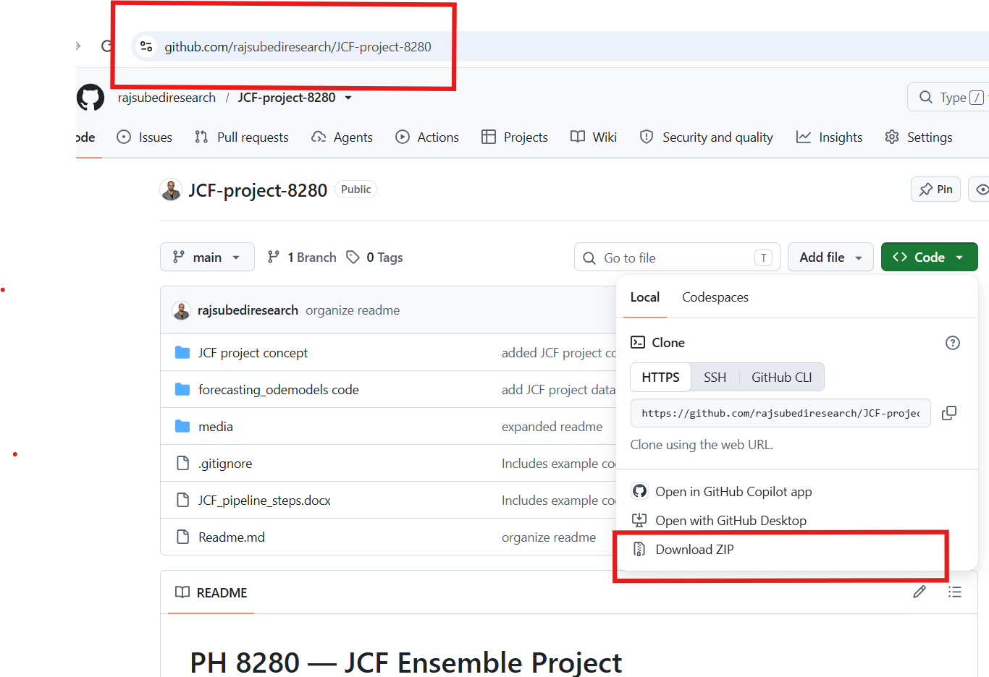
Prerequisites and setup
Download the repo https://github.com/rajsubediresearch/JCF-project-8280

Slide 4
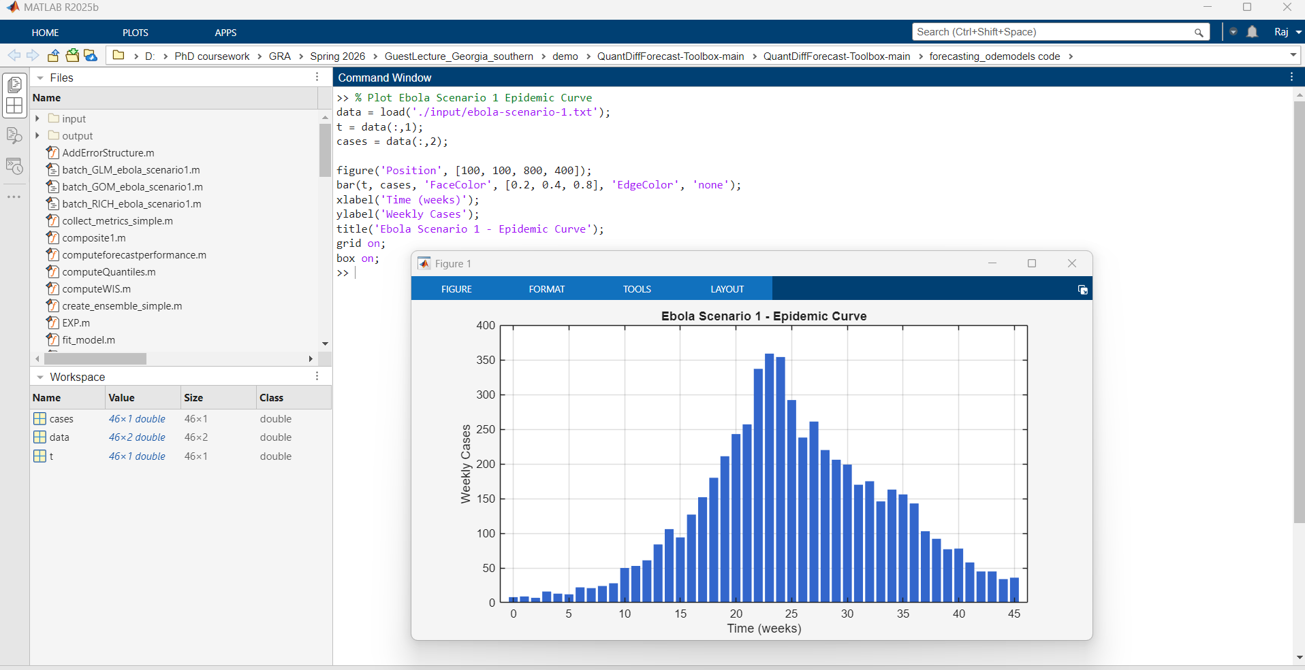
Why more than one model
The shape of the curve changes over time during an outbreak due to
  depleting susceptibles,
  interventions,
  behaviour change,
  spread into new subpopulations,
  and changes in reporting
The model that fits best early is rarely the one that fits best later !!

Slide 5
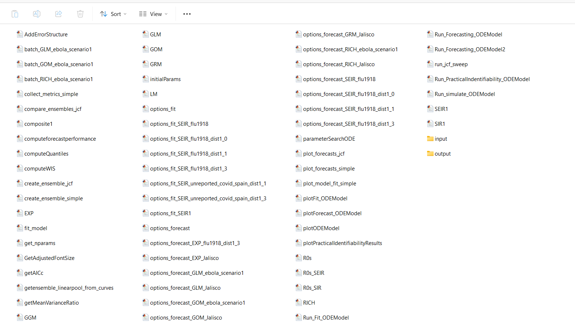
Revisiting QuantDiffForecast toolbox
Data file
Output folder
Phenomenological models in the toolbox:
Exponential Model (EXP)
Generalized Growth Model (GGM)
Logistic Growth Model (LM)
Generalized Logistic Growth Model (GLM)
Richards Model (RICH)
Gompertz Model (GOM)
Generalized Richards Model (GRM)

Slide 6
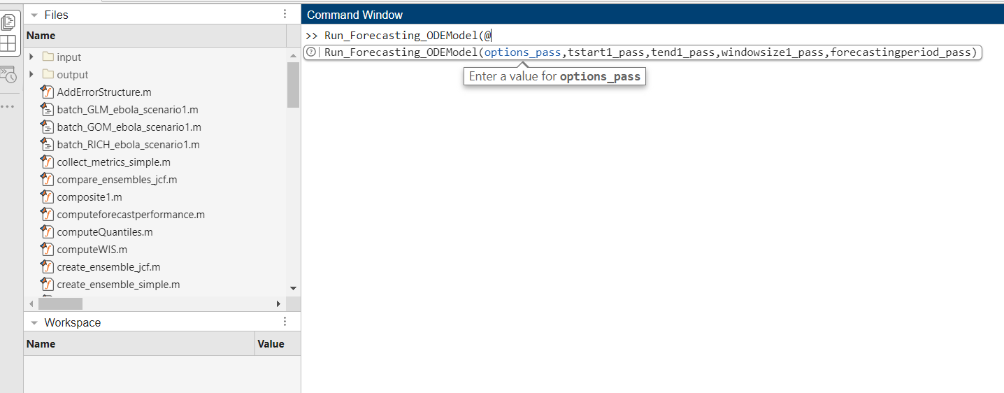
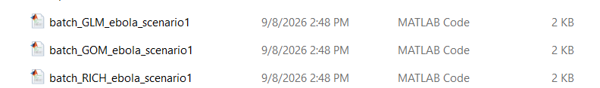
Sequential windows forecasting (e.g. shifting windows by forecast horizon)
Examples:
Run_Forecasting_ODEModel(@options_forecast_GLM_ebola_scenario1,1,1,20,4)
Run_Forecasting_ODEModel(@options_forecast_GLM_ebola_scenario1,5,5,20,4)
Run_Forecasting_ODEModel(@options_forecast_GLM_ebola_scenario1,9,9,20,4)
Run_Forecasting_ODEModel(@options_forecast_GLM_ebola_scenario1,13,13,20,4)
Run_Forecasting_ODEModel(@options_forecast_GLM_ebola_scenario1,17,17,20,4)
Instead of running the sequential forecasting one by one, we can make a wrapper file and automate the forecasting process

Slide 7
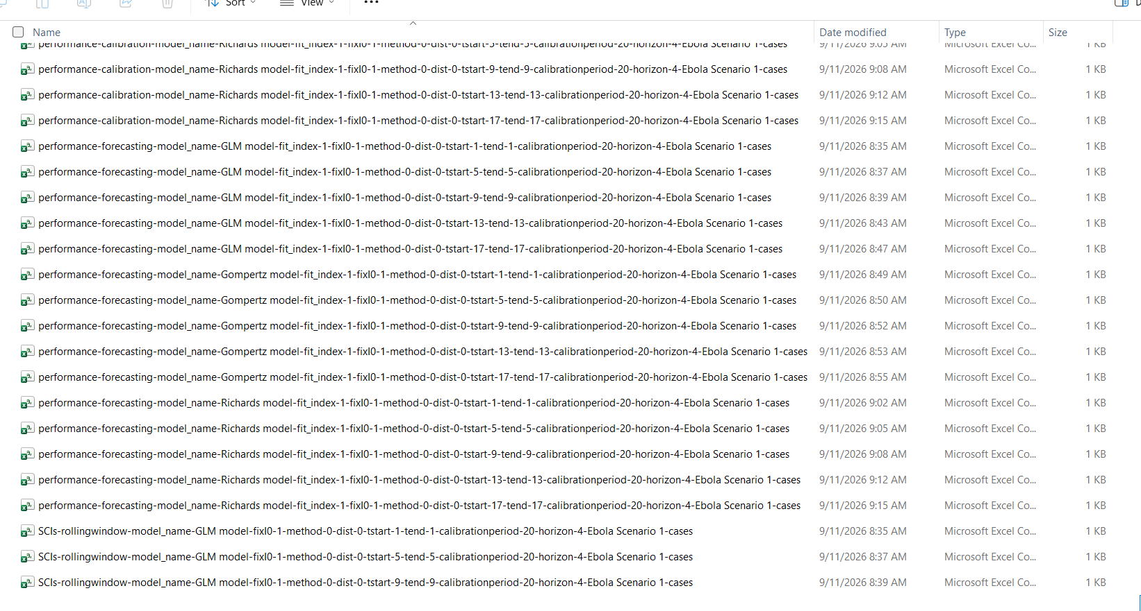
Model performance metrics
Calibration metrics
Forecast Metrics

Slide 8
The ensemble and the linear pool
Once each model has produced a predictive distribution for each future week, we combine them.
We use linear pool approach (see getensemble_linearpool_from_curves.m for details)

Slide 9
Calibration-only weighting, and its blind spot
This is common practice (and is reasonable). However:
  Calibration WIS is in-sample.
  It scores the model on data the model has already seen and has been tuned to.
  Over-fitting models might not forecast well

Slide 10
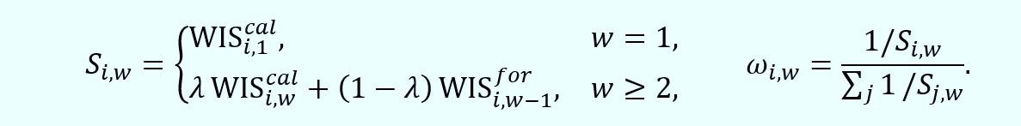
JCF ensembles and the role of λ
For each model in each window, we form a score that is a blend of two numbers: lambda times the current window’s calibration WIS, plus one minus lambda times the previous window’s forecast WIS.
Then, the weight is one over that score, normalized.
See details at https://github.com/rajsubediresearch/JCF-project-8280

Slide 11
Practice
Copy the files from the repository https://github.com/rajsubediresearch/JCF-project-8280 folder to your QuantDiffForecast toolbox including the datasets. You don’t have to replace the existing files.
Run these in order:
  batch_GLM_ebola_scenario1
  batch_GOM_ebola_scenario1
  batch_RICH_ebola_scenario1
  collect_metrics_simple()
  create_ensemble_simple()
  plot_model_fit_simple()
  plot_forecasts_simple()
  run_jcf_sweep()
  compare_ensembles_jcf()
  plot_forecasts_jcf()

Slide 12
Optional (making editable plots)
%Using built in plot editor of matlab to edit the .fig files
fig_files = dir('foldername/*.fig');
for i = 1:length(fig_files)
filepath = fullfile(fig_files(i).folder, fig_files(i).name);
fig = openfig(filepath, 'invisible');
set(fig, 'Visible', 'on');
drawnow;
saveas(fig, filepath); % Overwrite with corrected visibility
close(fig);
fprintf('Fixed: %s\n', fig_files(i).name);
end

